Slide 1
String, Regular Expression, DateTime in C#,

Slide 2

Lesson Objectives
String
String in C#
StringFormat
String Interpolation
StringBuilder
Regular Expression
DateTime
DateTime in General
DateTime Format
TimeSpan in C#
DateTime Conversion

Slide 3
String in C#
Section 1.1

Slide 4
String in C#
A string is an object of type String whose value is text.
The text is stored as a sequential read-only collection of Char objects.
There is no null-terminating character at the end of a C# string;
C# string can contain any number of embedded null characters ('\0').

Slide 5
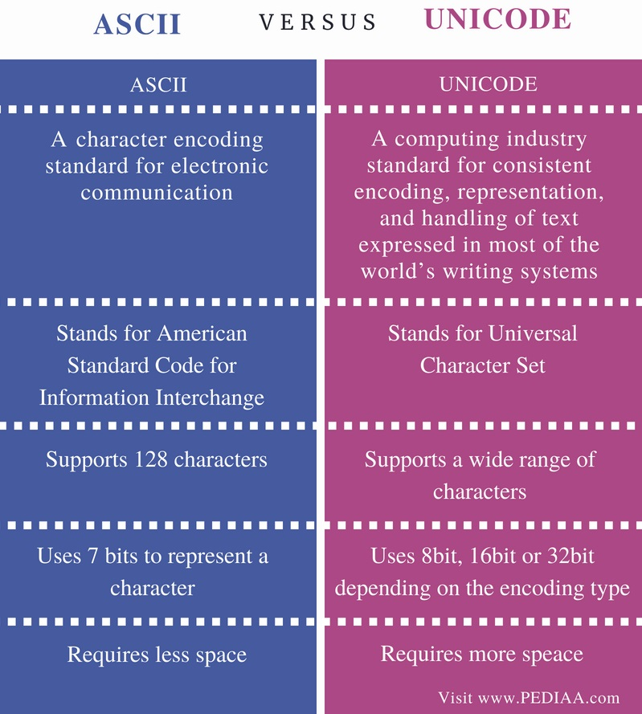
ASCII vs. Unicode character
ASCII represents lowercase letters (a-z), uppercase letters (A-Z), digits (0-9) and symbols such as punctuation marks
Unicode represents letters of English, Arabic, Greek etc., mathematical symbols, historical scripts, and emoji covering a wide range of characters than ASCII.

Slide 6
string vs. System.String
In C#, the string keyword is an alias for String.
String and string are equivalent, and you can use whichever naming convention you prefer.
The String class provides many methods for safely creating, manipulating, and comparing strings.
In addition, the C# language overloads some operators to simplify common string operations.

Slide 7
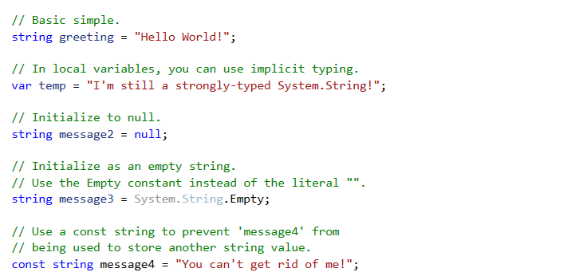
First example

Slide 8
String operators
string firstName = "Tony"; | string lastName = "Stark"; | Result
firstName + lastName |  | "TonyStark"
firstName == lastName |  | false
firstName != lastName |  | true

Slide 9
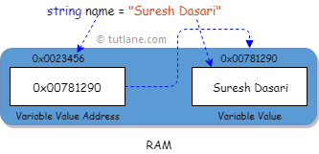
String is a Reference type
Stored on the heap
No default value
Nullable
BUT: Behaves Like Value Type

Slide 10
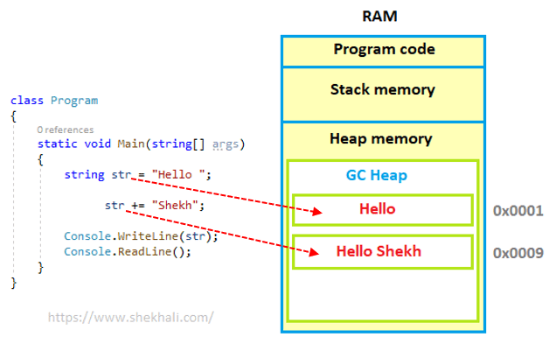
Immutability of String Objects
String objects are immutable: they cannot be changed after they have been created.
All of the String methods and C# operators that appear to modify a string actually return the results in a new string object.

Slide 11
String Escape
Escape sequence | Character name | Unicode encoding
\' | Single quote | 0x0027
\" | Double quote | 0x0022
\\ | Backslash | 0x005C
\b | Backspace | 0x0008
\n | New line | 0x000A
\r | Carriage return | 0x000D
\t | Horizontal tab | 0x0009

Slide 12
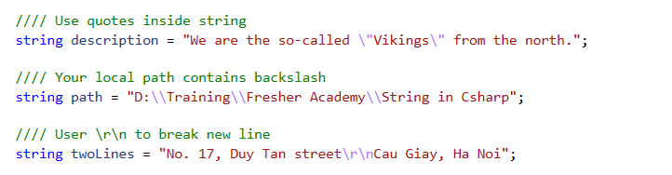
String Escape

Slide 13
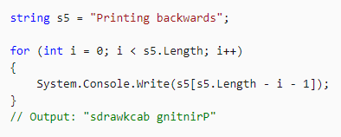
Accessing Individual Characters
Use array notation with an index value to acquire read-only access to individual characters
It works like a array of characters

Slide 14
Null Strings and Empty Strings
An empty string is an instance of a System.String object that contains zero characters.
Empty strings are used often in various programming scenarios to represent a blank text field.
You can call methods on empty strings because they are valid System.String objects
A null string does not refer to an instance of a System.String object and any attempt to call a method on a null string causes a NullReferenceException.
You can use null strings in concatenation and comparison operations with other strings.

Slide 15
String methods
Compare string
Logical comparison
Equal method
Compare method
IsNullOrEmpty
IsNullOrWhiteSpace
Concatenate strings
Add operator: for simple
Concat method
Join method
StringBuilder
Standardize string
Trim, TrimStart, TrimEnd
Split
IndexOf, IndexOfAny, LastIndexOf
ToLower
ToUpper
Extract string
Contains
Substring
StartWith
EndWith

Slide 16
Practice time
Problem: Give a string contains some number. Use string method to extract all number and get some of them
Example: “Peter has 3 oranges, 4 apples and 1.2 kg strawberry” should return 8.2
Create a method to resolve problem
Input: string
Output: decimal

Slide 17
String format
Section 1.2

Slide 18
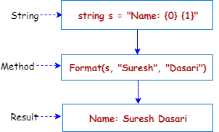
String.Format
Converts the value of objects to strings based on the formats specified and inserts them into another string.
Use String.Format if you need to insert the value of an object, variable, or expression into another string.

Slide 19
String.Format
Benefit:
Clear & Clean
Reuseable
Avoid bug
Example:
Give:
string firstName = "Tony";
string lastName = "Stark";
int age = 53;
int suite = 85;
Create string: “Tony Stark (53 years old) has made and used around 85 different suites.”

Slide 20

Control formatting
You can follow the index in a format item with a format string to control how an object is formatted.

Slide 21
Standard numeric format strings
Format specifier | Name | Description | Examples
"C" or "c" | Currency | Result: A currency value. | 123.456 ("C", en-US) -> $123.46
"D" or "d" | Decimal | Result: Integer digits with optional negative sign. | 1234 ("D") -> 1234
"E" or "e" | Exponential (scientific) | Result: Exponential notation. | 1052.0329112756 ("E", en-US) -> 1.052033E+003
"F" or "f" | Fixed-point | Result: Integral and decimal digits with optional negative sign. | 1234.567 ("F", en-US) -> 1234.57
"G" or "g" | General | Result: The more compact of either fixed-point or scientific notation. | -123.456 ("G", en-US) -> -123.456
"N" or "n" | Number | Result: Integral and decimal digits, group separators, and a decimal separator with optional negative sign. | 1234.567 ("N", en-US) -> 1,234.57
"P" or "p" | Percent | Result: Number multiplied by 100 and displayed with a percent symbol. | 1 ("P", en-US) -> 100.00 %
"R" or "r" | Round-trip | Result: A string that can round-trip to an identical number. | 123456789.12345678 ("R") -> 123456789.12345678
"X" or "x" | Hexadecimal | Result: A hexadecimal string. | 255 ("X") -> FF

Slide 22
Custom numeric format strings
Format specifier | Name | Description | Examples
"0" | Zero placeholder | Replaces the zero with the corresponding digit if one is present; otherwise, zero appears in the result string. | 1234.5678 ("00000") -> 01235
"#" | Digit placeholder | Replaces the "#" symbol with the corresponding digit if one is present; otherwise, no digit appears in the result string. | 1234.5678 ("#####") -> 1235
"." | Decimal point | Determines the location of the decimal separator in the result string. | 0.45678 ("0.00", en-US) -> 0.46
"," | Group separator and number scaling | Serves as both a group separator and a number scaling specifier. As a group separator, it inserts a localized group separator character between each group. As a number scaling specifier, it divides a number by 1000 for each comma specified. | Group separator specifier:
"%" | Percentage placeholder | Multiplies a number by 100 and inserts a localized percentage symbol in the result string. | 0.3697 ("%#0.00", en-US) -> %36.97
"‰" | Per mille placeholder | Multiplies a number by 1000 and inserts a localized per mille symbol in the result string. | 0.03697 ("#0.00‰", en-US) -> 36.97‰

Slide 23
Standard date and time format strings
Format specifier | Description | Examples
"d" | Short date pattern. | 2009-06-15T13:45:30 -> 6/15/2009 (en-US)
"D" | Long date pattern. | 2009-06-15T13:45:30 -> Monday, June 15, 2009 (en-US)
"f" | Full date/time pattern (short time). | 2009-06-15T13:45:30 -> Monday, June 15, 2009 1:45 PM (en-US)
"F" | Full date/time pattern (long time). | 2009-06-15T13:45:30 -> Monday, June 15, 2009 1:45:30 PM (en-US)
"g" | General date/time pattern (short time). | 2009-06-15T13:45:30 -> 6/15/2009 1:45 PM (en-US)
"G" | General date/time pattern (long time). | 2009-06-15T13:45:30 -> 6/15/2009 1:45:30 PM (en-US)
"M", "m" | Month/day pattern. | 2009-06-15T13:45:30 -> June 15 (en-US)
"Y", "y" | Year month pattern. | 2009-06-15T13:45:30 -> June 2009 (en-US)

Slide 24
Custom date and time format strings
Rules:
Use character for value. Example: y for year, d for day,
M for month and m for minute
H for 24-hour and h for 12-hour (following by tt mean AM/PM)
Number of characters is length of value

Slide 25
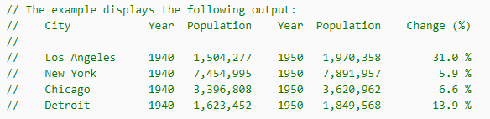
Practice time
Use string format with control formatting to print data as bellow:
Notes:
String.Format("{0,-12}{1,8:yyyy}{2,12:N0}{3,8:yyyy}{4,12:N0}{5,14:P1}",

Slide 26

String Interpolation
Use string interpolation to format and include expression results in a result string.
To identify a string literal as an interpolated string, prepend it with the $ symbol. You can embed any valid C# expression that returns a value in an interpolated string.

Slide 27
String Interpolation
To include a brace, "{" or "}", in a result string, use two braces, "{{" or "}}“
As the colon (":") has special meaning in an item with an interpolation expression, in order to use a conditional operator in an expression, enclose it in parentheses,

Slide 28
StringBuilder
Section 1.3

Slide 29
StringBuilder
String is immutable reference type
StringBuilder represents a mutable string of characters.
A StringBuilder object maintains a buffer to accommodate expansions to the string.
New data is appended to the buffer if room is available; otherwise, a new, larger buffer is allocated, data from the original buffer is copied to the new buffer, and the new data is then appended to the new buffer.

Slide 30
String and StringBuilder in practice
Use String when:
Use StringBuilder when:
The number of changes that your app will make to a string is small.
You are performing a fixed number of concatenation operations, particularly with string literals.
You have to perform extensive search operations while you are building your string
You expect your app to make an unknown number of changes to a string at design time.
You expect your app to make a significant number of changes to a string

Slide 31
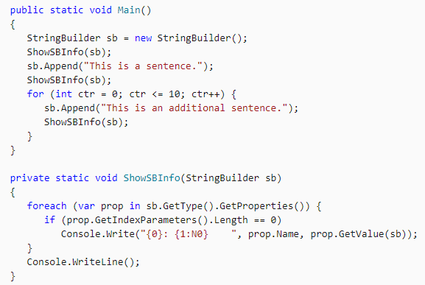
Example

Slide 32
Memory allocation
The default capacity of a StringBuilder object is 16 characters, and its default maximum capacity is Int32.MaxValue (~2 billions)
Whenever the existing capacity is inadequate, additional memory is allocated and the capacity of a StringBuilder object doubles up to the value defined by the MaxCapacity property.

Slide 33
StringBuilder method
Append
appends the string representation of a specified value (any data type)
AppendLine
appends a copy of the specified string followed by the default line terminator to the end
AppendFormat
appends the string returned by processing a composite format string

Slide 34
StringBuilder method
Insert
Inserts the string representation of a value at the specified character position.
Replace
Replaces all occurrences of a specified value (character or string) in this instance with another specified value.
Remove
Removes the specified range of characters from this instance.
ToString
Converts the value to a String

Slide 35
Regular Expressions
Section 2

Slide 36
Regular Expression
A regular expression (aka: regex) is a pattern that could be matched against an input text.
The Regex class represents the .NET Framework's regular expression engine.
It can be used to quickly parse large amounts of text to:
find specific character patterns;
to extract, edit, replace, or delete text substrings;
and to add the extracted strings to a collection to generate a report.

Slide 37
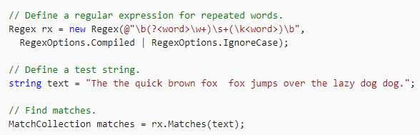
Regular Expression

Slide 38
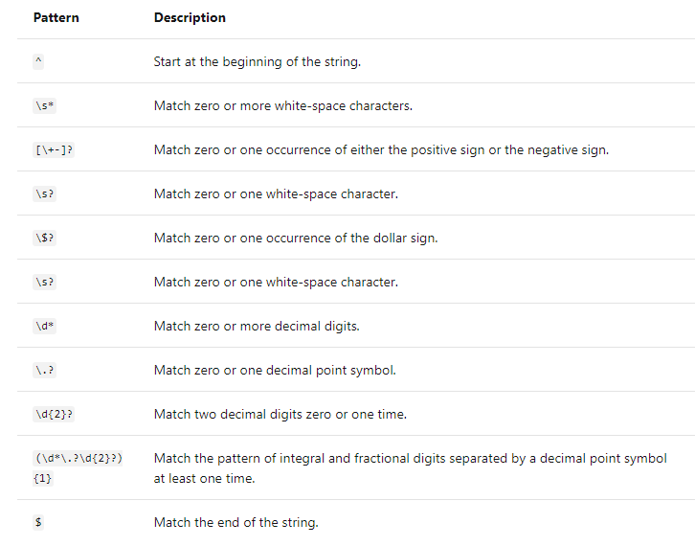
Regular Expression

Slide 39
Main method
IsMatch
Indicates whether the regular expression specified in the Regex constructor finds a match in a specified input string.
Match
Searches the specified input string for the first occurrence of the regular expression specified.

Slide 40
Main method
Replace
In a specified input string, replaces all strings that match a regular expression pattern with a specified replacement string.
Split
Splits an input string into an array of substrings at the positions defined by a regular expression pattern specified

Slide 41
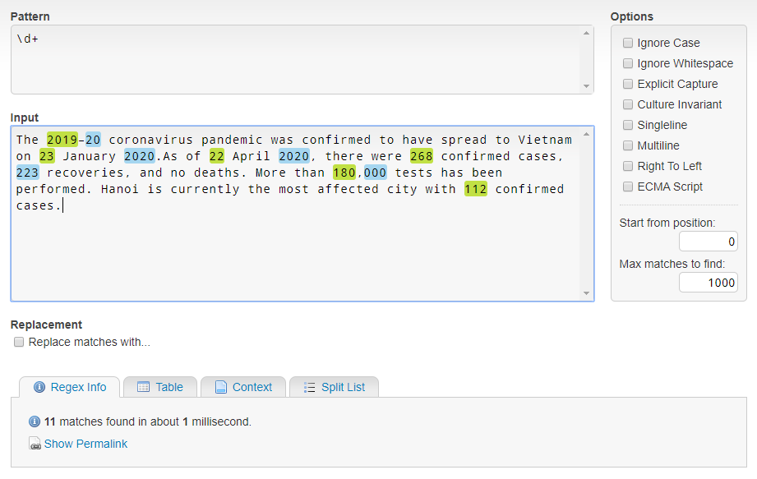
References
http://regexstorm.net/tester

Slide 42
Lesson Summary
String in C#
StringFormat
String Interpolation
StringBuilder
Regular Expression

Slide 43
DateTime in General
Section 3.1

Slide 44
DateTime in General
Greenwich Mean Time (GMT):
is the mean solar time at the Royal Observatory in Greenwich, London, reckoned from midnight
Coordinated Universal Time (UTC)
is the primary time standard by which the world regulates clocks and time.
TimeZone: defines local date and time
Vietnam: UTC+7
Singapore/Kuala Lumpur: UTC+8
Unix (Epoch time):
defined as the number of seconds from 00:00:00 on 1 January 1970

Slide 45
DateTime in C#
The DateTime value type represents dates and times with values:
ranging from 00:00:00 (midnight), January 1, 0001 Anno Domini (Common Era)
through 11:59:59 P.M., December 31, 9999 A.D. (C.E.) in the Gregorian calendar.
Time values are measured in 100-nanosecond units called ticks.
In practice, you should choose Date and Time or Date only format

Slide 46
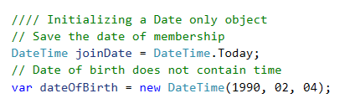
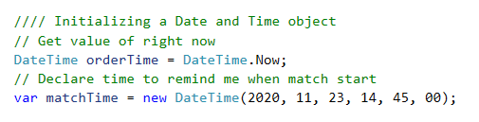
Initializing a DateTime object
When we focus on Date only
When the time is important

Slide 47
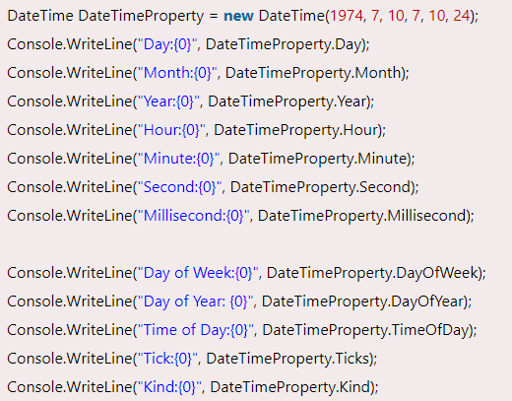
DateTime in C#
DayOfWeek: gets the day of the week represented by this instance.
DayOfYear: gets the day of the year represented by this instance
TimeOfDay: gets the time of day for this instance.
DaysInMonth: returns the number of days in the specified month and year.

Slide 48
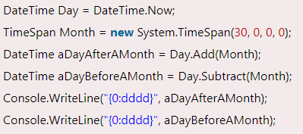
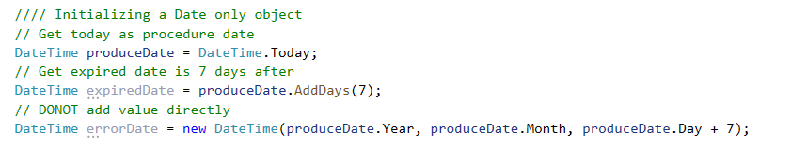
DateTime in C#
Use Add<member> methods to Add (or Subtract) from current value
Example:
Notes:
Loại bug này khó phát hiện, vì phải đợi đến ngày nó mới xảy ra lỗi
Cần phải chú ý test được những trường hợp này

Slide 49
Compare Two DateTime In C#
Use Compare method to compare two DateTime objects.
If result is 0, both objects are the same.
If the result is less than 0, then the first DateTime is earlier;
otherwise the first DateTime is later.
Use CompareTo method compare current date with an other.
If result is 0, both objects are the same.
If the result is less than 0, then the first DateTime is earlier;
otherwise the first DateTime is later.

Slide 50
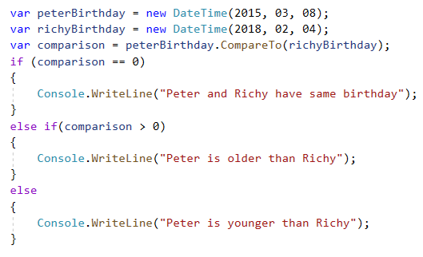
Compare Two DateTime In C#

Slide 51
DateTime Format
Section 3.2

Slide 52
DateTime format
We use date time format to define the text representation of the date and time value
CultureInfo represents information about a specific culture.
The information includes the names for the culture, the writing system, the calendar used, the sort order of strings, and formatting for dates and numbers.

Slide 53
DateTime format
In DateTime, it shows difference format, 26 Feb 2030
en-US: 2/26/2030
en-GB, fr-FR, vi-VN: 26/02/2030
ja-JP: 2030/02/26
Important: always check CultureInfo to get date or month
Example: you got a datetime value as 07/05/1987
Is it: 07-May or 05-Jul?

Slide 54
Standard date and time format strings
Format specifier | Description | Examples
"d" | Short date pattern. | 2009-06-15T13:45:30 -> 6/15/2009 (en-US)
"D" | Long date pattern. | 2009-06-15T13:45:30 -> Monday, June 15, 2009 (en-US)
"f" | Full date/time pattern (short time). | 2009-06-15T13:45:30 -> Monday, June 15, 2009 1:45 PM (en-US)
"F" | Full date/time pattern (long time). | 2009-06-15T13:45:30 -> Monday, June 15, 2009 1:45:30 PM (en-US)
"g" | General date/time pattern (short time). | 2009-06-15T13:45:30 -> 6/15/2009 1:45 PM (en-US)
"G" | General date/time pattern (long time). | 2009-06-15T13:45:30 -> 6/15/2009 1:45:30 PM (en-US)
"M", "m" | Month/day pattern. | 2009-06-15T13:45:30 -> June 15 (en-US)
"Y", "y" | Year month pattern. | 2009-06-15T13:45:30 -> June 2009 (en-US)

Slide 55
Custom date and time format strings
Rules:
Use character for value. Example: y for year, d for day,
M for month and m for minute
H for 24-hour and h for 12-hour (following by tt mean AM/PM)
Number of characters is length of value
Practice to use some custom format:
"d/M/yyyy"
"dd/MM/yyyy"
"dd/MMM/yyyy"
"dd/MMMM/yyyy"
"MMM d, yyyy"
Notes:
Thực hành sử dụng các custom format và rút ra nhận xét

Slide 56
TimeSpan
TimeSpan represents a period of time and has many helpful methods.
TimeSpan contains days, hours, minutes, seconds, miliseconds
TimeSpan is used in DateTime operators

Slide 57
DateTime Operators
DateTime.Add:
adds the value of the specified System.TimeSpan
DateTime.Subtraction
Subtracts the specified date and time from this instance.

Slide 58
DateTime Operators
Operator |  | DateTime | TimeSpan
+ | DateTime |  | TimeSpan
 | TimeSpan | TimeSpan
- | DateTime | TimeSpan
 | TimeSpan | DateTime | TimeSpan
==, !=, >, >=, < <= | DateTime | bool
 | TimeSpan |  | bool

Slide 59
Convert DateTime to string
Use DateTime format CultureInfo
Always check CultureInfo
Be consider UTC time

Slide 60
Convert string to DateTime
Always check format before convert
From local machine
From data example
From requirement
Use Parser methods
DateTime.Parse
DateTime.ParseExact
TryParse
TryParseExact

Slide 61
Practice Time
Create application to allow display local time at difference cities
User input date and time
User input local code
User input list of countries
Application shows local time at cities
Technical requirement:
Application accepts at least 3 formats date and time
Application accept list of countries in format:
<country name 1>(<culture code 1>), < country name 2>(< culture code 2>), < country name 3>(< culture code 3>),
You can use various for application output
Notes:
LIST OF .NET CULTURE AND COUNTRY CODES
https://lonewolfonline.net/list-net-culture-country-codes/

Slide 62
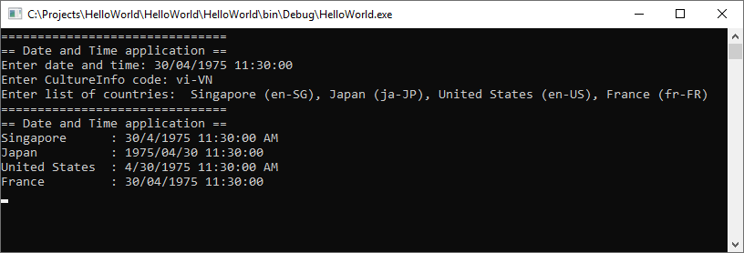

Slide 63

Thank you

